Slide 1
LECTURE 01
Introduction to Project Management

Slide 2
Learning Objectives
Understand the growing need for better project management, especially for information technology (IT) projects
Explain what a project is, provide examples of IT projects, list various attributes of projects, and describe the triple constraint of project management
Describe project management and discuss key elements of the project management framework, including project stakeholders, the project management knowledge areas, common tools and techniques, and project success

Slide 3
Learning Objectives
Discuss the relationship between project, program, and portfolio management and the contributions each makes to enterprise success
Understand the role of project managers by describing what they do, what skills they need, and career opportunities for IT project managers
Describe the project management profession and the advancement of project management software

Slide 4
Introduction
Many organizations today have a new or renewed interest in project management
Worldwide IT spending was $3.8 trillion in 2014, a 3.2 percent increase from 2013 spending
The Project Management Institute estimates demand for 15.7 million project management jobs from 2010 to 2020

Slide 5
Project Management Statistics
In 2013 (the most recent year of PMI’s salary survey), the average salary in U.S. dollars
$108,000 per year in the United States
$134,658 in Australia, (the highest-paid country)
$24,201 in Egypt (the lowest-paid country)
The top skills employers look for in new college graduates are all related to project management: team-work, decision-making, problem-solving, and verbal communications
Organizations waste $109 million for every $1 billion spent on projects, according to PMI’s Pulse of the Profession® report

Slide 6
Motivation for Studying ITPM
What Went Wrong?
A 1995 Standish Group study (CHAOS) found that only 16.2% of IT projects were successful in meeting scope, time, and cost goals; over 31% of IT projects were canceled before completion
A PricewaterhouseCoopers (PwC) study found that overall half of all projects fail and only 2.5% of corporations consistently meet their targets for scope, time, and cost goals for all types of project

Slide 7
Advantages of Using Formal PM
Better control of financial, physical, and human resources
Improved customer relations
Shorter development times
Lower costs
Higher quality and increased reliability
Higher profit margins
Improved productivity
Better internal coordination
Higher worker morale

Slide 8
What is a Project?
A project is “a temporary endeavor undertaken to create a unique product, service, or result” (PMBOK® Guide, Fifth Edition, 2013)
Operations is work done to sustain the business
Projects end when their objectives have been reached or the project has been terminated
Projects can be large or small and take a short or long time to complete

Slide 9
Examples of IT Projects
A team of students creates a smartphone application and sells it online
A company develops a driverless car
A government group develops a system to track child immunizations
A global bank acquires other financial institutions and needs to consolidate systems and procedures

Slide 10
Top Strategic Technologies for 2012 (Gartner)
Computing everywhere
The Internet of things
3D printing
Advanced, pervasive, and invisible analytics
*Refer to GARTNER’S TECH HYPE CYCLE

Slide 11
Media Snapshot: Unproductive Apps
Gartner predicted that by 2014, there would be more than 70 billion mobile application downloads every year, but it was almost double
Facebook is by far the most downloaded app, and the most popular category of all apps continues to be games
The challenge is to develop useful apps and get workers to focus on them instead of the many distracting options available

Slide 12
Project Attributes
A project
has a unique purpose
is temporary
is developed using progressive elaboration
requires resources, often from various areas
should have a primary customer or sponsor
The project sponsor usually provides the direction and funding for the project
involves uncertainty

Slide 13
Project & Program Managers
Project managers work with project sponsors, project team, and other people involved in a project to meet project goals
Program: group of related projects managed in a coordinated way to obtain benefits and control not available from managing them individually (PMBOK® Guide, Fifth Edition, 2013)
Program managers oversee programs; often act as bosses for project managers

Slide 14
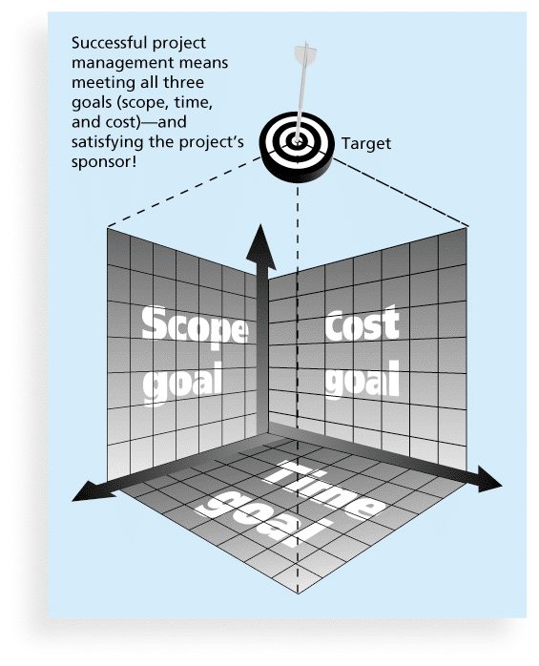
Figure 1-1 The Triple Constraint of Project Management

Slide 15
What is Project Management?
Project management is “the application of knowledge, skills, tools and techniques to project activities to meet project requirements” (PMBOK® Guide, Fourth Edition, 2013)
Project managers strive to meet the triple constraint (project scope, time, and cost goals) and also facilitate the entire process to meet the needs and expectations of project stakeholders

Slide 16
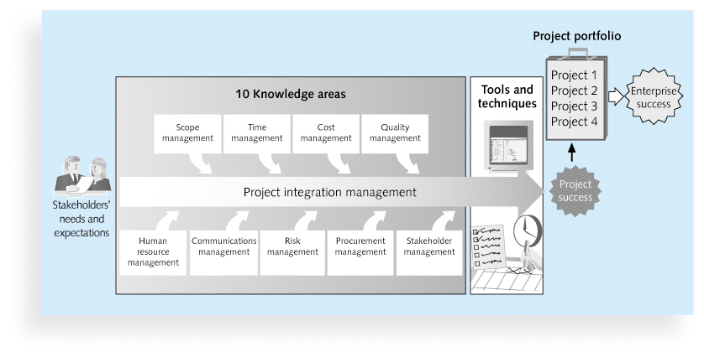
Figure 1-2 Project Management Framework

Slide 17
Project Stakeholders
Stakeholders are the people involved in or affected by project activities
Stakeholders include
the project sponsor
the project manager
the project team
support staff
customers
users
suppliers
opponents to the project

Slide 18
10 PM Knowledge Areas
Knowledge areas describe the key competencies that project managers must develop
Project managers must have knowledge and skills in all 10 knowledge areas
integration
scope
time
cost
quality
human resource
communications
risk
procurement
stakeholder management

Slide 19
PM Tools & Techniques
Project management tools and techniques assist project managers and their teams in various aspects of project management
Some specific ones include
Project charter, scope statement, and WBS (scope)
Gantt charts, network diagrams, critical path analysis, critical chain scheduling (time)
Cost estimates and earned value management (cost)

Slide 20
What Went Right? Improved Project Performance
The Standish Group’s CHAOS studies show improvements in IT projects in the past decade:
The number of successful IT projects has more than doubled, from 16% in 1994 to 39% in 2012
The number of failed projects decreased from 31% in 1994 to 18% in 2012
Success rates were much higher for small projects than large ones – 76% versus 10%

Slide 21
Project Success
There are several ways to define project success:
The project met scope, time, and cost goals
The project satisfied the customer/sponsor
The results of the project met its main objective, such as making or saving a certain amount of money, providing a good return on investment, or simply making the sponsors happy

Slide 22
Table 1-2: What Helps Projects Succeed?*
Executive support
User involvement
Clear business objectives
Emotional maturity
Optimizing scope
Agile process
Project management expertise
Skilled resources
Execution
Tools and infrastructure

Slide 23
Top 3 Reasons Why Federal Technology Project Succeed
Adequate funding
Staff expertise
Engagement from all stakeholders

Slide 24
Program & Project Portfolio Management
A program is “a group of related projects managed in a coordinated way to obtain benefits and control not available from managing them individually” (PMBOK® Guide, Fifth Edition, 2013)
A program manager provides leadership and direction for the project managers heading the projects within the program
Examples of common programs in the IT field include infrastructure, applications development, and user support

Slide 25
Project Portfolio Management
As part of project portfolio management, organizations group and manage projects and programs as a portfolio of investments that contribute to the entire enterprise’s success
Portfolio managers help their organizations make wise investment decisions by helping to select and analyze projects from a strategic perspective

Slide 26
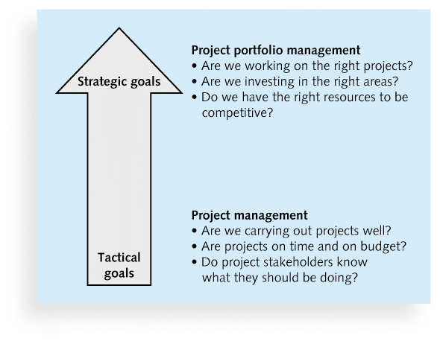
Figure 1-3. PM Compared to Project Portfolio Management

Slide 27
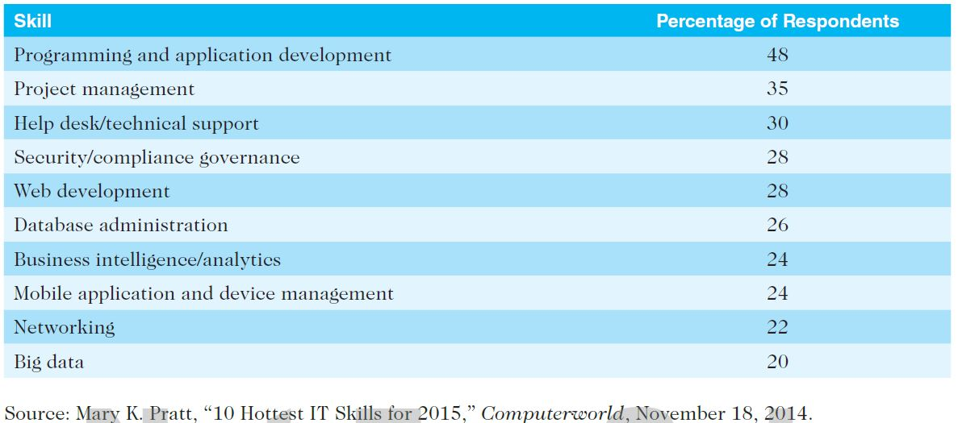
Table 1-4. Ten Hottest IT Skills

Slide 28
PM Offices
In the 100s, many companies began creating PMOs to help them handle the increasing number and complexity of projects
A Project Management Office (PMO) is an organizational group responsible for coordinating the project management function throughout an organization

Slide 29
PM Software
There are hundreds of different products to assist in performing project management
Three main categories of tools:
Low-end tools: Handle single or smaller projects well, cost under $200 per user
Midrange tools: Handle multiple projects and users, cost $200-$1,000 per user, Project 2013 most popular
High-end tools: Also called enterprise project management software, often licensed on a per-user basis
Several free or open-source tools are also available

Slide 30
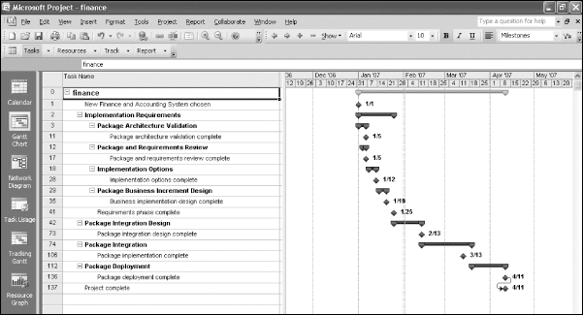
Figure 1-6. Sample Gantt Chart Created with Project 2013

Slide 31
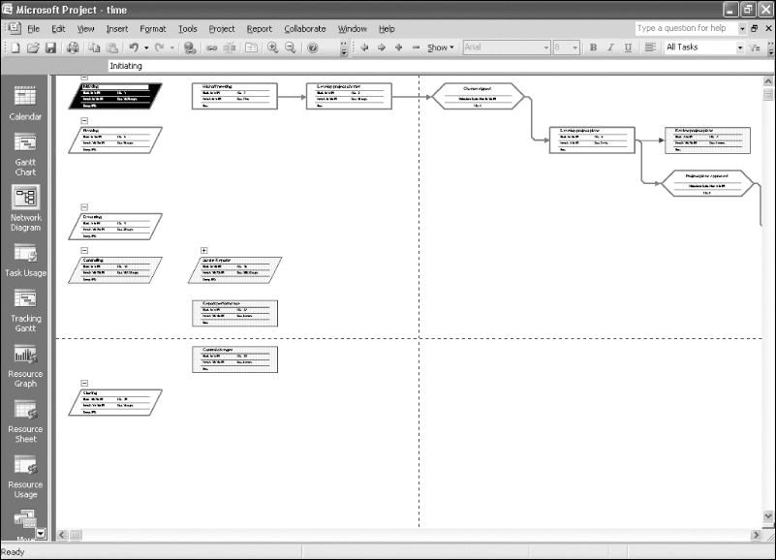
Figure 1-7. Sample Network Diagram Created with Project 2013

Slide 32
Chapter Summary
A project is a temporary endeavor undertaken to create a unique product, service, or result
Project management is the application of knowledge, skills, tools, and techniques to project activities to meet project requirements
A program is a group of related projects managed in a coordinated way
Project portfolio management involves organizing and managing projects and programs as a portfolio of investments
Project managers play a key role in helping projects and organizations succeed
The project management profession continues to grow and mature

Slide 33
Questions & answers

